Slide 1
Extended SEIR Model & Social Measure Analytics
40.015 Simulation Modeling & Analysis
Team 2
Hongyue Ding 1004870
Ziyu Ge 1004880
Zhuoer Feng 1004871

Slide 2
Key Features
Separation of symptoms – Asymptomatic, symptomatic, and severe
More accurate modeling of parameters such as infectious & death rate
Separation of population – High-risk & low-risk group
Different key parameters such as the fraction of severe cases & death rate
Modeling of resource utilization – ICU need
ICU need affects death rate for severe cases
Exploration of group-specific measure
Comparison with common uniform social measures

Slide 3
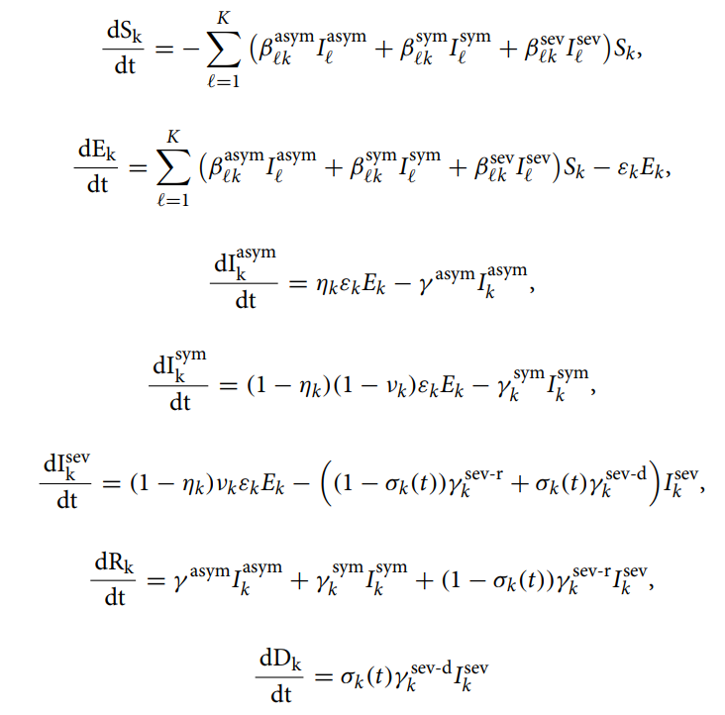
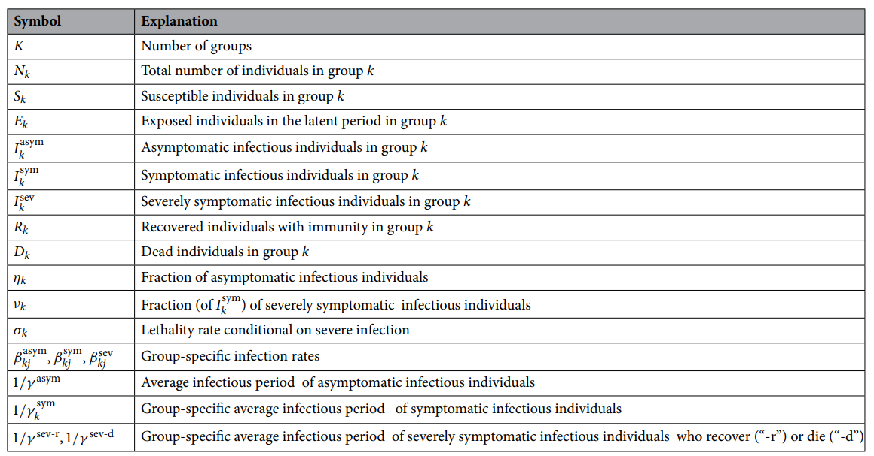
SEI³RD Model

Slide 4

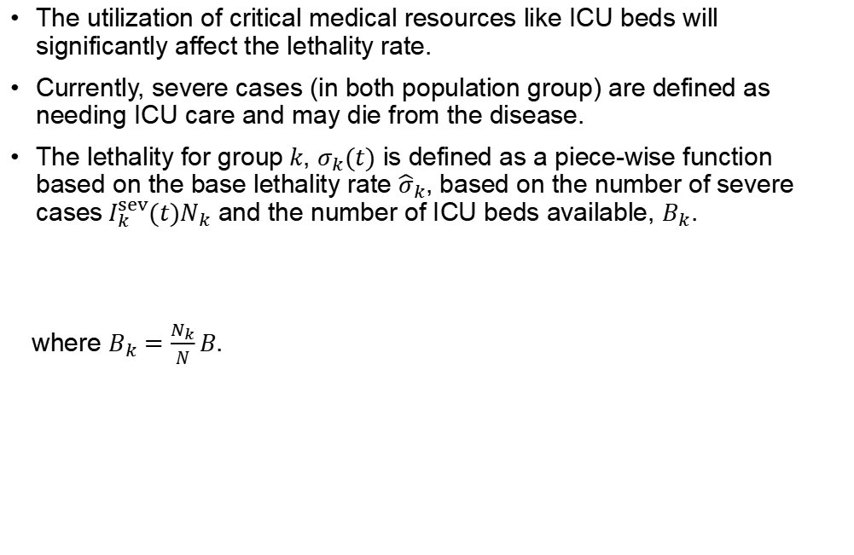
Modeling of Medical Resource Utilization
The utilization of critical medical resources like ICU beds will significantly affect the lethality rate.
Currently, severe cases (in both population group) are defined as needing ICU care and may die from the disease.
The lethality for group$k$, $σ_{k}(t)$ is defined as a piece-wise function based on the base lethality rate ${\hat{σ}}_{k}$, based on the number of severe cases${ I}_{k}^{sev}(t)N_{k}$ and the number of ICU beds available, $B_{k}$.
where $B_{k}=\frac{N_{k}}{N}B$.

Slide 5
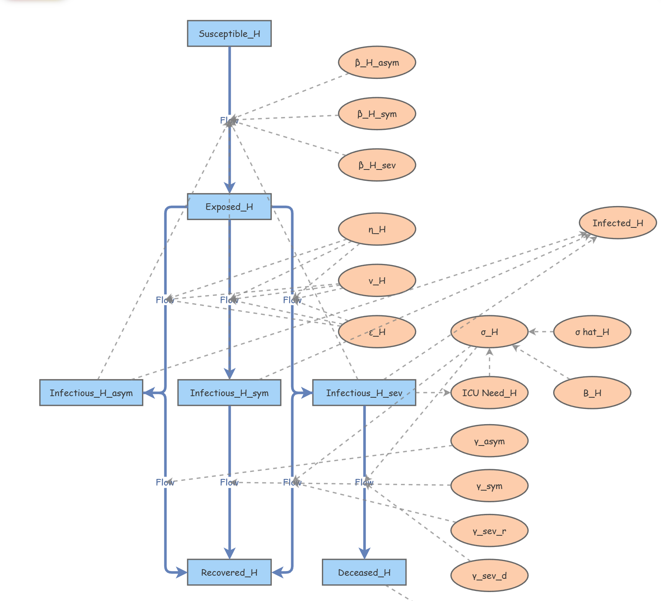
Model 1: Benchmark
We first consider a benchmark model in which no measures are taken, below is the model for the high-risk group.
The model for low-risk group is similar, the different parameters are listed below:
β_H(L)_asym | 0.1
β_H(L)_sym | 0.18
β_H(L)_sev | 0.18
ν_H | 0.045
ν_L | 0.0075
ε_H | 0.4
ε_L | 0.1

Slide 6
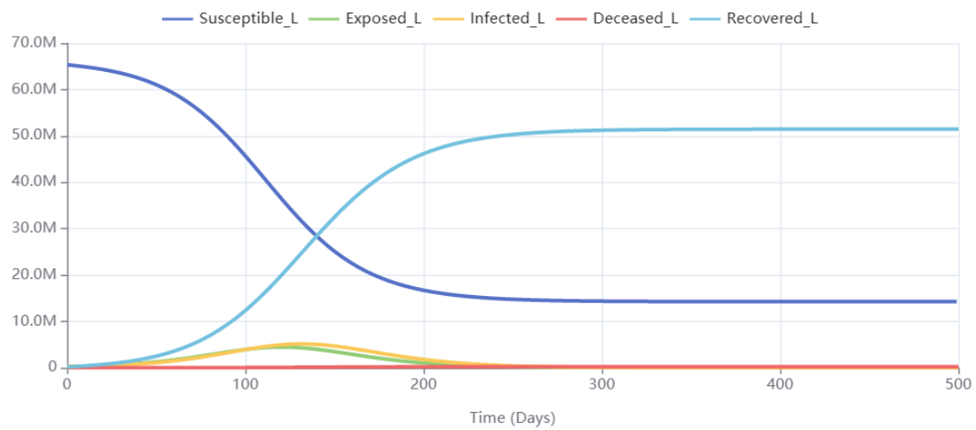
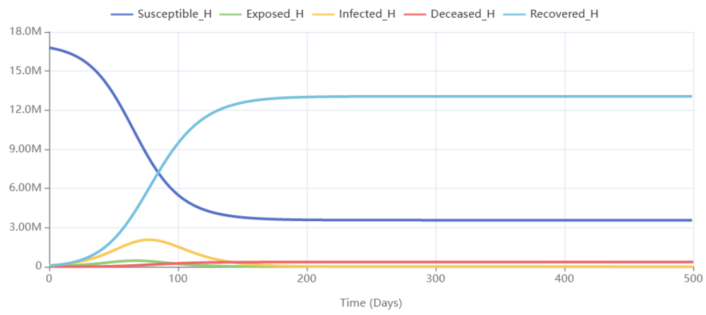
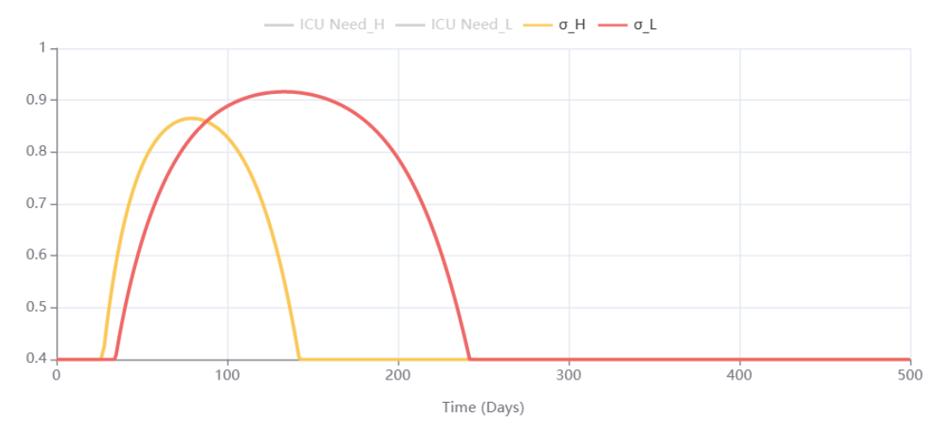
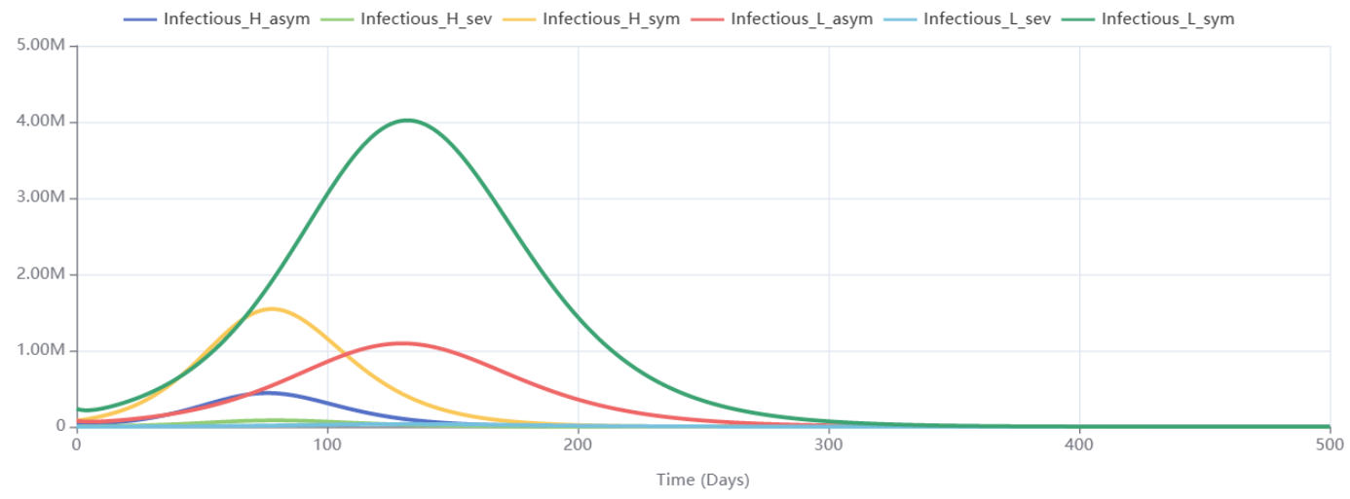
Model 1: Benchmark
As we can see, the virus will die out after around 300 days, infecting 80% of the population
However, the ICU was overwhelmed after only 30 days, and the overrun lasted until day ~240.
This led to a total death of around 615K

Slide 7
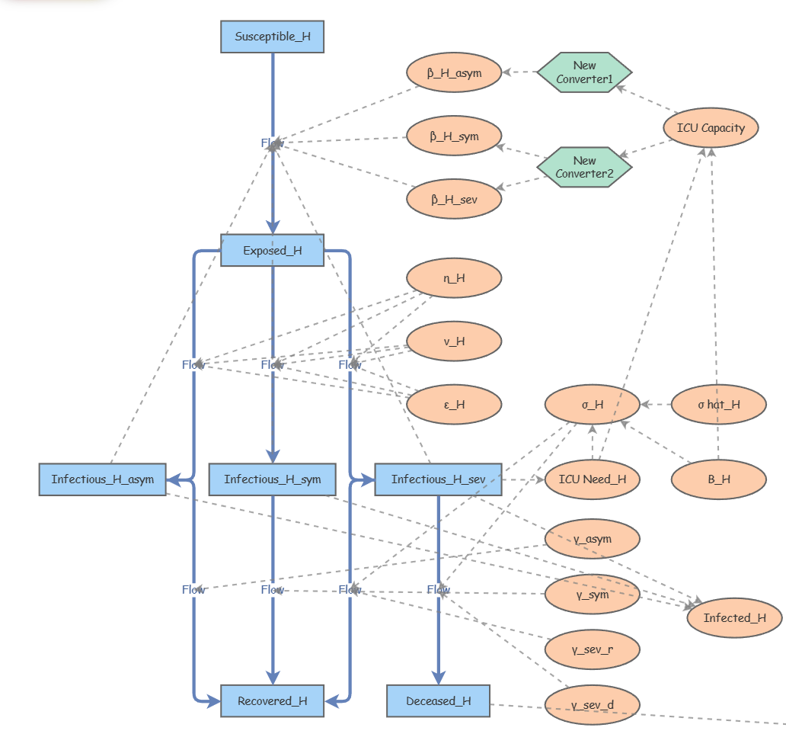
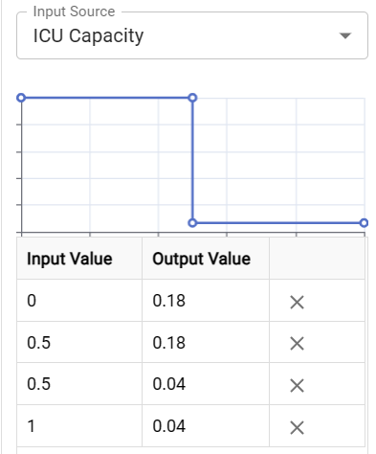
Model 2: Uniform Social Measure (USM)
We then consider the common model where all groups are subjected to the same social distancing measures.
The extent to which is based on the ICU capacity by using a converter. The β values will change after the ICU utilization hits the threshold.
We also would like to compare the effect of different threshold values (relaxed, moderate, and aggressive)
β_H(L)_asym’ | 0.04
β_H(L)_sym’ | 0.04
β_H(L)_sev’ | 0.04
ICU Capacity Threshold | 0.5 | 0.65 | 0.8

Slide 8
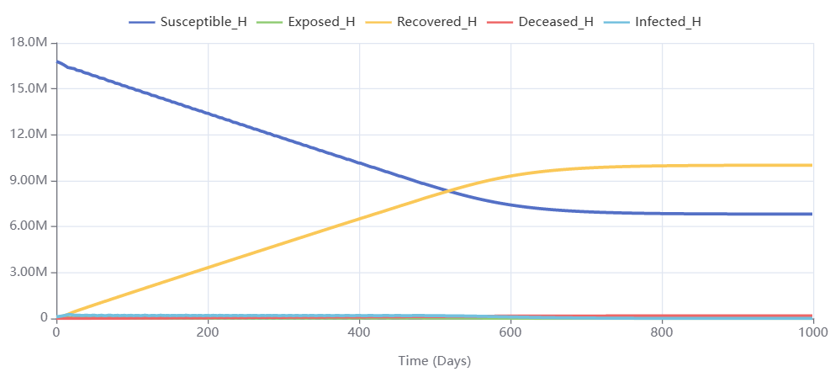
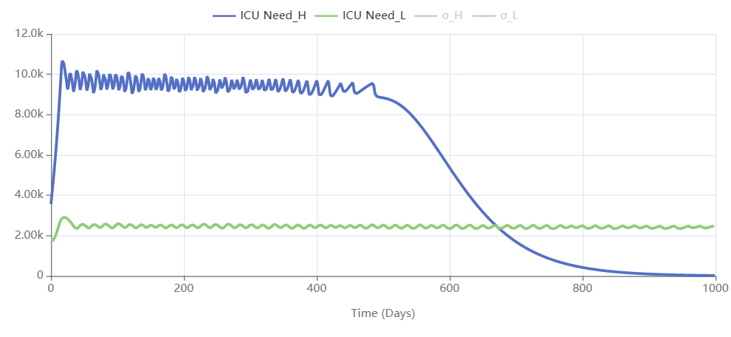
Model 2: Uniform Social Measure (USM)
We learned that uniform social distancing:
Not effective at reducing the overall infection with >60% infection rate
Very effective at smoothing the increase in cases (longer stabilization time)
Very effective at reducing overall death and ICU load, with ICU never exceeded capacity
No significant difference between policies
Policy | Aggressive | Moderate | Relaxed
Threshold | 0.5 | 0.65 | 0.8
Stabilization (High-risk) | Day ~700 | Day ~600 | Day ~480
Total Death | 235k | 260k | 275k
ICU Max Load | ~13k | ~18k | ~21k
Aggressive policy shown above

Slide 9
Model 3: Group-specific Measure (GSM)
We would like to simulate and evaluate the case where the measures are group specific to protect vulnerable population while maintaining economic activities. (i.e., only require mask wearing but no lockdown)
Similarly, we can compare different policies with different β values after implementation. We will use 0.65 as the ICU capacity threshold.
For aggressive policy, we are suggesting (slightly) stricter measures for the high-risk group compared to USM.
Policy | Aggressive | Moderate | Relaxed
β_H_asym’ | 0.03 | 0.04 | 0.04
β_H_sym’ | 0.03 | 0.04 | 0.04
β_H_sev’ | 0.03 | 0.04 | 0.04
β_L_asym’ | 0.06 | 0.07 | 0.08
β_L_sym’ | 0.1 | 0.12 | 0.15
β_L_sev’ | 0.1 | 0.12 | 0.15

Slide 10
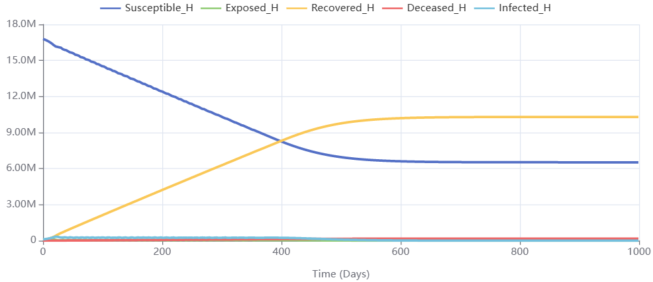
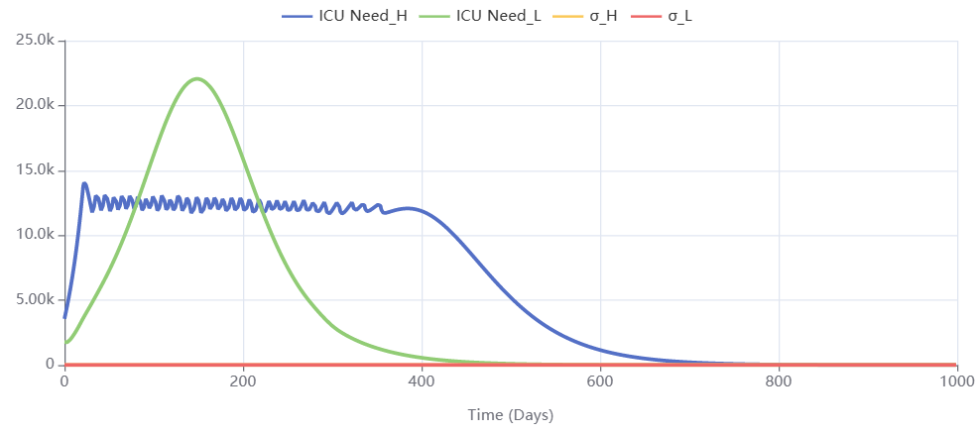
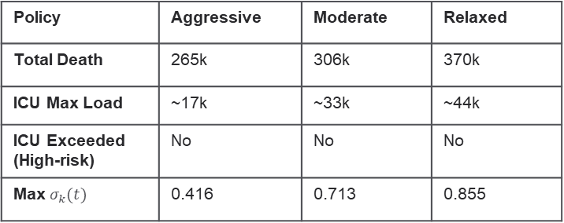
Model 3: Group-specific Measure (GSM)
Not a big sacrifice in terms of total death compared to uniform social measures
Roughly the same total death under the aggressive assumption with 2.5 times the beta
ICU capacity was not exceeded for high-risk
Actual ICU utilization for low-risk group should be better since we have ICU bed left over for high-risk group
Policy | Aggressive | Moderate | Relaxed
Total Death | 265k | 306k | 370k
ICU Max Load | ~17k | ~33k | ~44k
ICU Exceeded (High-risk) | No | No | No
Max $σ_{k}(t)$ | 0.416 | 0.713 | 0.855
Relaxed policy shown above

